Slide 1
Big mountain course of action
By, Josh thomason

Slide 2
Problem identification
Higher operating costs, due to the added chair lifts, without increasing the profits/revenue.
Need to create a scenario were there is an ability to either lower the costs or increase the ticket price/revenue.
Create a model to best predict the best course of action given the assumptions given by you.

Slide 3
Recommendations & key Findings
NO CHANGE: Model predicted you could increase price without making any changes.
1: Closing one run will not lower the associated ticket price, but will in hand lower the costs of running the resort
2: Increasing the vertical drop by adding a 150 feet lower run will increase the associated ticket price by approximately $9-$10
BUT we don’t know the associated costs.
3: Increasing the run and snow making coverage will increase the ticket price by approximately $10-$11
DON’T know associated costs
Recommendation: Find the associated costs for scenario 2-3, and see if the increased revenue is worth it
OR, if closing one run and keeping ticket price constant will decrease costs enough to be the most beneficial

Slide 4
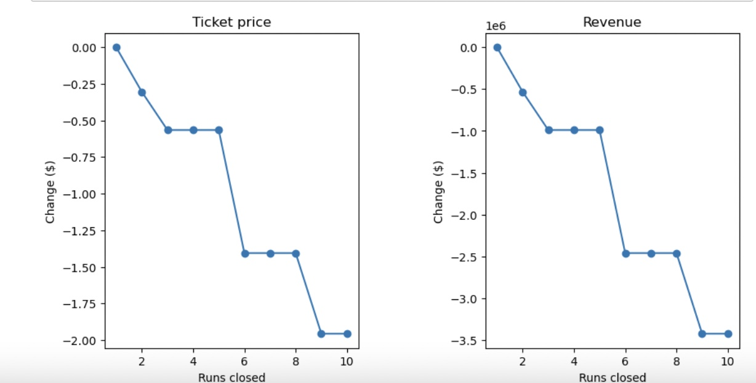
Scenario One:
The decrease in one run is not predicted to cause a decrease in the demand for a ticket at the same cost.

Slide 5
Scenario 2:
Assumptions: 350,000 visitors during season, average of 5 days per stay (per person)
Using these assumptions given by you, revenue will increase by approximately $1,700,000
Need to understand that this may not increase profit, because there will be added costs
Figure out what the costs of adding a run that is 150 feet lower would be, and subtract that from the predicted revenue increase.

Slide 6
Scenario 3:
Same assumptions given during prediction
Increasing the vertical drop (the same as scenario 2), while also increasing the snow making coverage by 2 acres.
This will increase seasonal revenue by approximately $1,800,000
NEED to see what the additional costs of the run and the added snow making coverage would be to see the predicted increase in profit.

Slide 7
No change in services/experience: just price increase
In the exploratory analysis we showed that you provide a higher tier experience, while not charging a higher tier price
You are above the mean for ticket price
BUT most of the price significant variables you offer are far higher than the mean offered by other resorts.
With a mean absolute error in our model of approximately $10, we predict that you could increase your ticket price from $81
Could increase price to anywhere around $84-$94

Slide 8
Conclusion
Take scenarios 1-3 as possible courses of action for you.
Scenario One: would decrease costs for you, while incurring no penalty in the ticket price you offer.
Scenario 2-3: would increase revenue significantly, but we are unsure of the incurred costs of these additions, so we can not accurately predict the increase in profit
NO CHANGE: Because of the experience you offer, our model predicted that you could raise the price without change
There is a mean absolute error of $10 for this model, but it predicts that you could increase the ticket price by anywhere from $4-$13, keeping everything constant.

